Slide 1
Big Data Computing
2021-2022
Fake News Detection using Pyspark
A presentation by: Albiona Guri - 1992979
Elvina Lika - 2024059

Slide 2
Outline
Introduction
Dataset
Models
Experimental results
Conclusion
A functional Application
Contribution

Slide 3
Introduction
The main objective of our project is to determine if a given text data by the user is fake or real.
It consists of a binary classification problem.
In order to automate the news qualifying procedure we implemented 4 machine learning algorithms to predict the news.

Slide 4
Dataset
The dataset we used is derived from Kaggle resource and is composed by text data.
It consists of around 44900 training examples.
The ratio between minority class and majority is particularly small.

Slide 5
Pre-Processing
Feature Engineering
Countvectorizer
- Bag of Words
TF-IDF
TEXT
Clean
Trim
Filter Punctuations
Remove extra Whitespaces
Tokenize
Stopwords Removal
Stemming

Slide 6
Models
Logistic Regression
Logistic Regression
2. Random Forest
Random Forest Classifier
3. Multilayer Perceptron
MultilayerPerceptronClassifier
4. Transformers
Hugging Face Transformer

Slide 7
Experimental Results

Slide 8
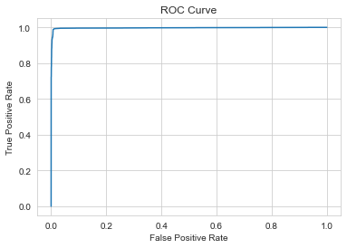
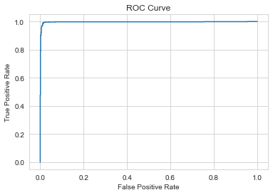
Logistic Regression
Train set
Test set

Slide 9


Random Forest
Train set
Test set

Slide 10


MultiLayer Perceptron
Train set
Test set

Slide 11
Results Summary
Metrics | Logistic Regression | Random Forest | Multilayer Perceptron | Transformers
Accuracy | 0.98831 | 0.99309 | 0.98353 | 0.99867
F1-Score Class 0 | 0.98851 | 0.99323 | 0.98381 | -
F1-Score Class 1 | 0.98810 | 0.99295 | 0.98325 | 0.99587
AUC | 0.99678 | 0.99876 | 0.99717 | 0.99852

Slide 12
Conclusion
Among all tested models in our dataset, we noticed that the best performance comes from:
Random Forest and Transformers
We built a small Application that can be used to get informed if the news are real or fake. The used model in our specific case is Transformers.
We have saved all the models, so we can adapt the Application for using each of them.

Slide 13
A functional Application
To put into practice our model, we built a small application where the user can enter the news and receive a feedback whether it is FAKE or REAL
Technologies used:
Flask
React.js
Docker
Links to the docker images:
https://hub.docker.com/repository/docker/elvinalika/fake-news-detector-fe
https://hub.docker.com/repository/docker/elvinalika/fake-news-detector-be

Slide 14
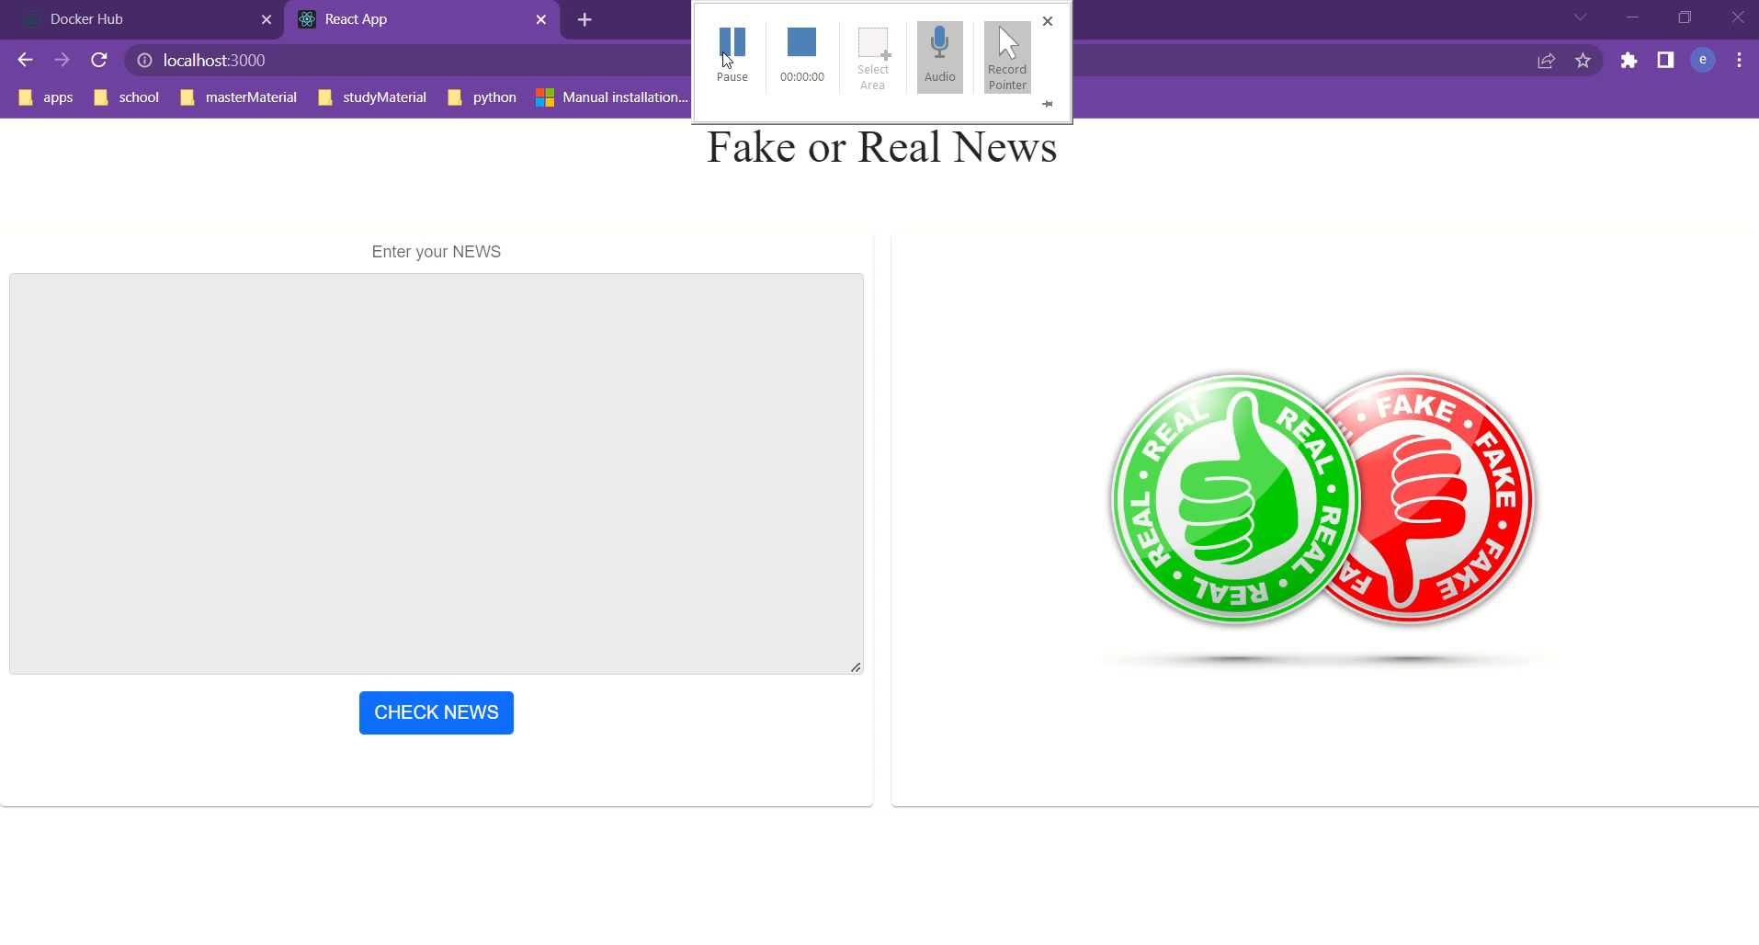
DEMO

Slide 15
Contribution
Both of team members contributed equally in each phase of the work, concretely:
Text Analyzing
Text Pre-processing
Feature Engineering
Functional Application
Individual work on training models and hyperparameter tuning
Logistic Regression and Random Forest: Elvina Lika
Multilayer Perceptron and Transformers: Albiona Guri

